Slide 1

COMPANY PROFILE

Slide 2

ABOUT US
BACKGROUND
We are a local Indonesian consulting services company engaged in management, engineering, planning, supervision and non-construction services
VISSION
Fulfilling national consultancy company needs with a good managerial foundation, consisting of professional teams, providing creative and solutions services .
MISSION
Realizing good corporate management
Providing & creating Professional Resources
Upholding work ethics (discipline, honesty and integrity)
Creative and solution consulting services

Slide 3
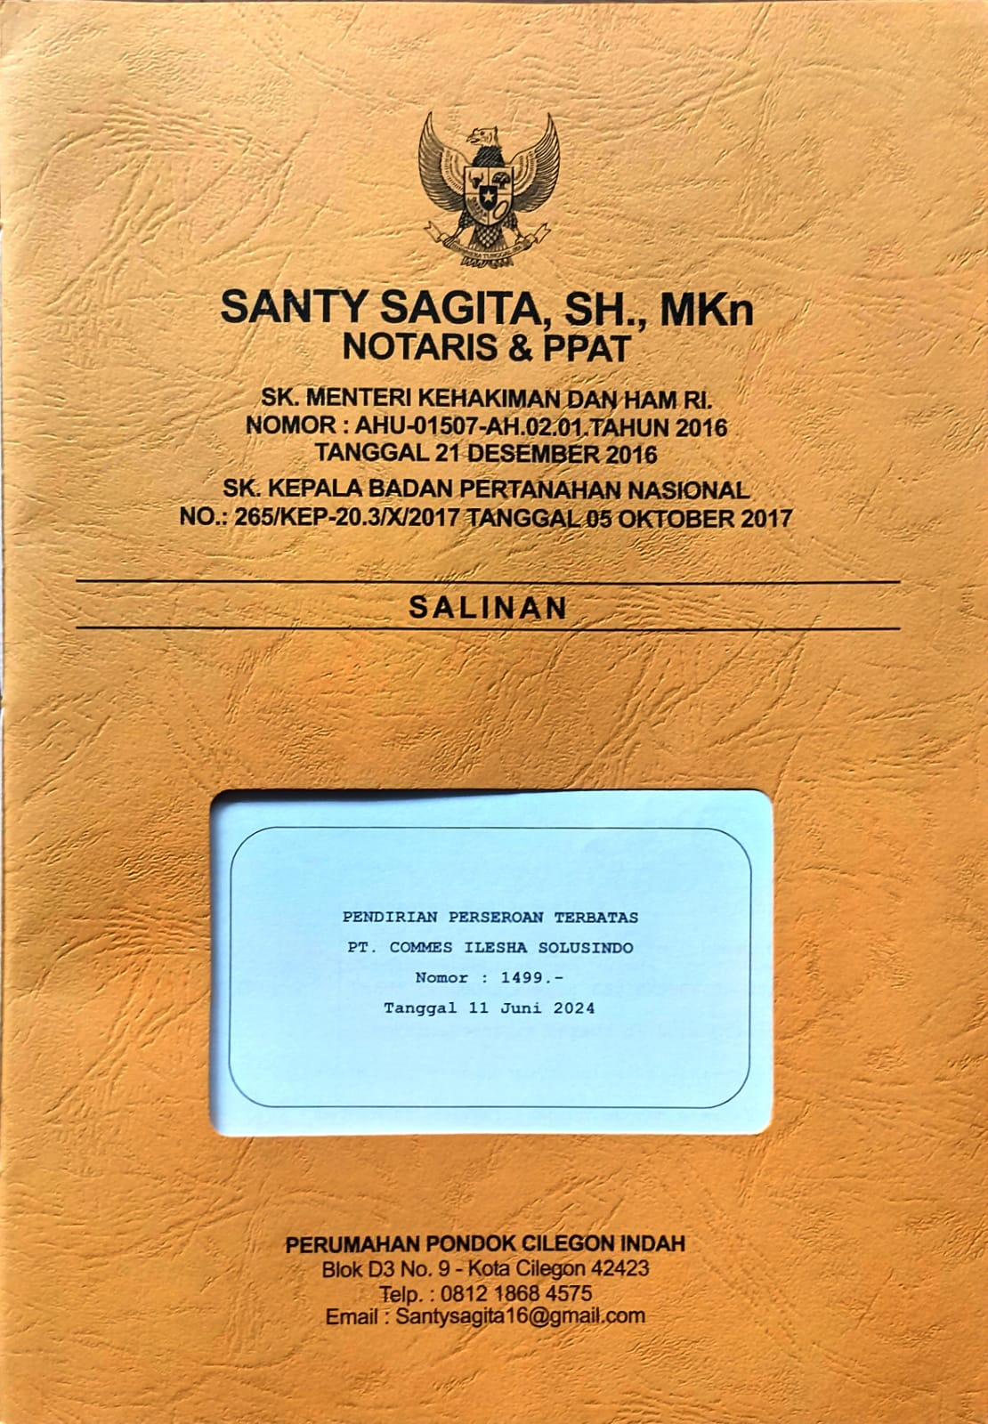
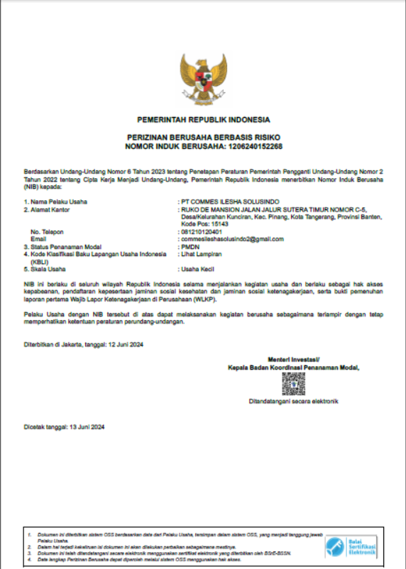
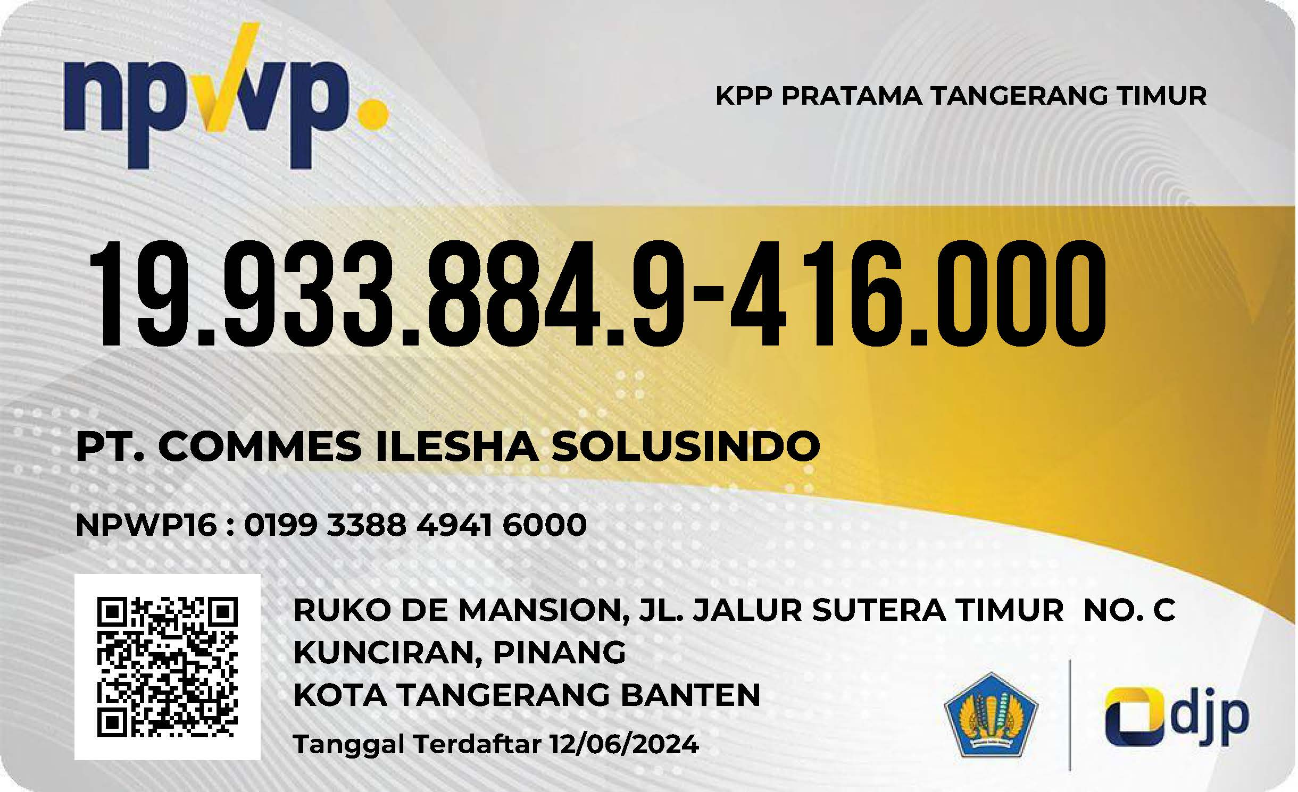
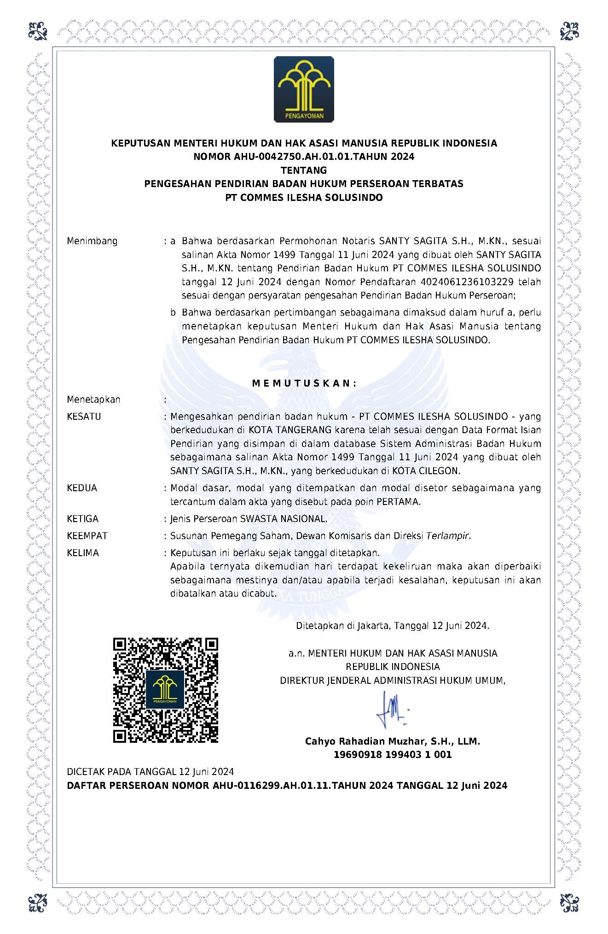
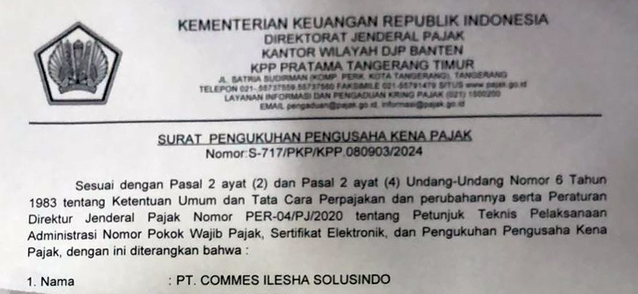
INTRODUCTION
LEGALITY COMPANY
NPWP
At Contoso, we empower organizations to foster collaborative thinking to further drive workplace innovation. By closing the loop and leveraging agile frameworks, we help business grow organically and foster a consumer-first mindset.​
AKTA NOTARIS
NIB
PENGUKUHAN PAJAK
SP KEMENKUMHAM

Slide 4

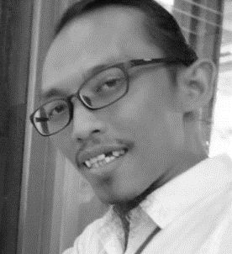

MAIN BUSINESS
WEDA GANESHA
Commissioner
ILHAM
Director
Construction Planning
Services
Oversight & Supervision
Services
Non Construction Planning
Services
Architectural classification
Engineering classification
Integrated Engineering classification
Landscape Architecture & Spatial Planning classification
Scientific & Engineering classification
Technical Testing & Analysis classification
Oversight Consultancy
Supervision Consultancy
Management Consultancy
Survey Services
Study Services, Research and Technical Assistance
Management Consulting Services
Special Services

Slide 5
PRIMARY GOALS
TECHNICAL SKILL
OIL & GAS
LINEPIPE
PROJECT MANAGEMENT
MECHANICAL & ELECTRICAL
WATER TREATMENT
IOT CONCEPT
PROJECT CONSULTANCY
TOLL ROAD
HIGH RISE BUILDING
CIVIL WORK
INFRASTRUCTURE
LANDSCAPE & ARCHITECTURAL
Annual revenue growth
SURVEY
CONSULTANCY
FRONT END
DETAIL ENG
ENGINEERING
We are developing Technical, qualitative & Quantitative all scope of survey
Personal & Company Assistancies project management consultancy
We create project planning & Designing including Feasability Studies
Serving Detail Design Engineering for Prepartation Project Running
Availbility Construction Project for infrastructure, Line Pipe, Building & Project Management Services

Slide 6
LAND SURVEY EXPERIENCE
2013
EPC 2 Banyu Urip Gas Pipeline 72 km
Onshore Offshore Gas Pipeline
Mobile Cepu Limited
1
2015
2
Arun - Belawan Gas Pipeline 365 Km
Topography RTK
Pertamina Gas - Indonesia
2016
Pangerang Gas Pipeline Project Underground Utilities Identification Petronas - Malaysia
3
2020
4
SPAM Umbulan Project
LiDar 3d Soil Investigation & Topograhy
Meta Adhya Tirta
2020-2022
Land Identification & Topography
SPAM Hilir Jatiluhur DKI Jakarta
SPAM Kabupaten Agam - Bukittinggi
SPAM Seriti –Tebing Tinggi
PT.Prismaita Cipta Kreasi - PUPR
5
2023
6
Detail Engineering Design
SPAM Kota Bekasi
Pemerintah Kota Bekasi (Disperkimtan)

Slide 7
FS FEED & DED EXPERIENCE
2016
Detail Engineering Design
Jaringan Gas Bumi Kota Bandar Lampung
PT.SENA – PGN - KESDM
1
2017
2
Detail Engineering Design
Jaringan Gas Bumi Kabupaten Serang
PT.SENA – PGN - KESDM
2018
Detail Engineering Design
Jaringan Gas Bumi Kota Tarakan
PT.SENA – PGN - KESDM
3
2019
4
Detail Engineering Design
Trunk Line Gas Pipeline Kaltara
PT.Prima Layanan Nasional Enjiniiring
2020-2022
Detail Engineering Design
SPAM Hilir Jatiluhur DKI Jakarta
SPAM Kabupaten Agam - Bukittinggi
SPAM Seriti –Tebing Tinggi
PT.Prismaita Cipta Kreasi - PUPR
5
2023
6
Detail Engineering Design
SPAM Kota Bekasi
Pemerintah Kota Bekasi (Disperkimtan)

Slide 8
CURENT PROJECT ON GOING
2023-Present
Engineering Service for Construction
SPAM Hilir Jatiluhur DKI Jakarta (Segmen 4)
PT.Daka – PT.Cipta Crown Simbol
1
2024
2
Supervision
Construction SPAM Kota Bekasi Dana Alokasi Khusus – Jatirangga – Tl pucung
Pemerintah Kota Bekasi (Disperkimtan)
2024
Detail Engineering Design
SPAM Kota Bekasi Zona 4 (Rawalumbu)
Pemerintah Kota Bekasi (Disperkimtan)
3
2024
4
Survey Monitoring
SPAM DAK TA 2023
Pemerintah Kota Bekasi (Disperkimtan)
2024
Supervision
Construction Distribution Pipe & Household Connection Cipendawa Kota Bekasi
Pemerintah Kota Bekasi (Disperkimtan)
5
2024
6
Design & Build (Engineering Services)
Rancang Bangun - Integrated Shrimp Farming Sumba Timur 2085 ha)
KSO Adhi Karya-Hutama Karya-Minarta

Slide 9
THANK YOU
For Further Information Details Don’t Hesitate to Contact Us…
commesileshasolusindo@gmail.com
+62 813 9290 6633 (weda)
For More Portfolio & Project complete, catch me...!

